Slide 1
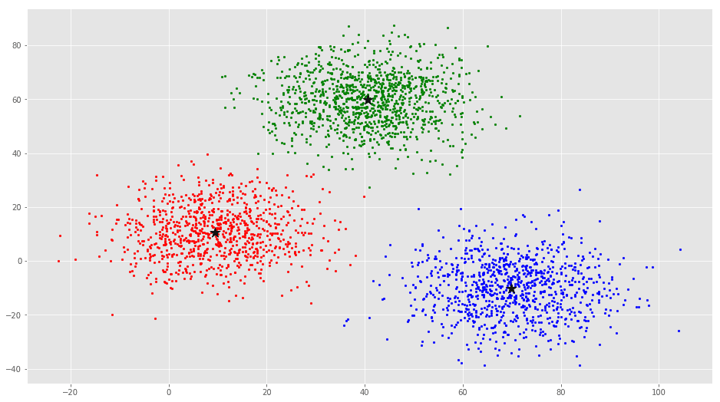
Unsupervised learning
K-means algorithm
Some slides taken from Andrew Ng’s Machine Learning course https://www.coursera.org/learn/machine-learning

Slide 2


Supervised learning
Training set:

Slide 3
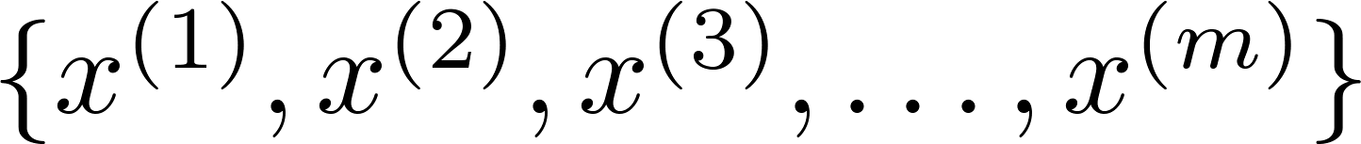
Unsupervised learning
Training set:

Slide 4
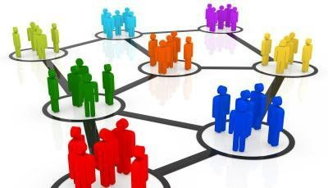
Clustering
Clustering is the task of partitioning the points into natural groups called clusters, such that points within a group are very similar, whereas points across clusters are as dissimilar as possible.

Slide 5


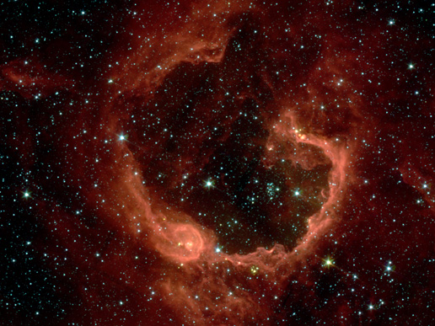
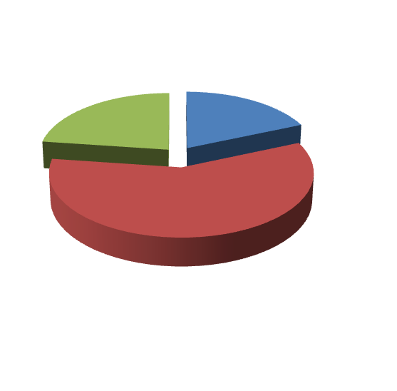
Applications of clustering
Market segmentation
Social network analysis
Image credit: NASA/JPL-Caltech/E. Churchwell (Univ. of Wisconsin, Madison)
Astronomical data analysis
Notes:
Swap: market seg and organize clusters

Slide 6
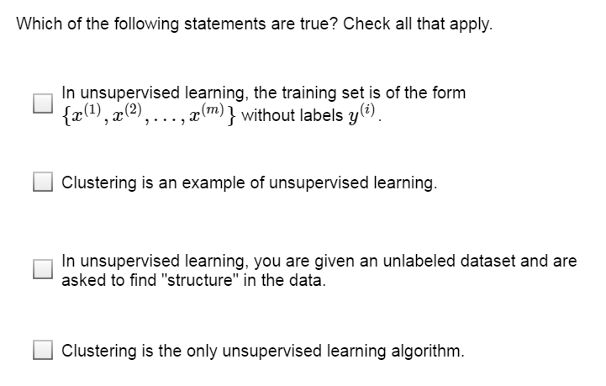

Slide 7
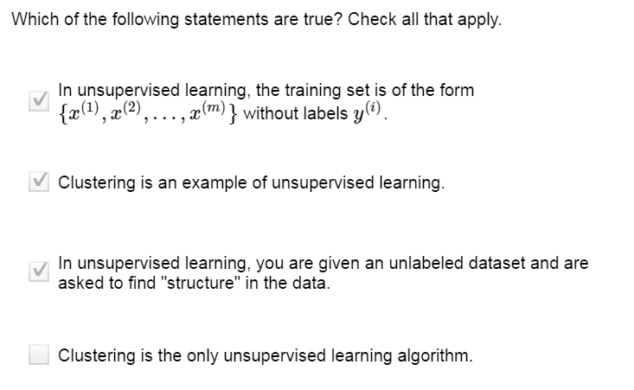

Slide 8
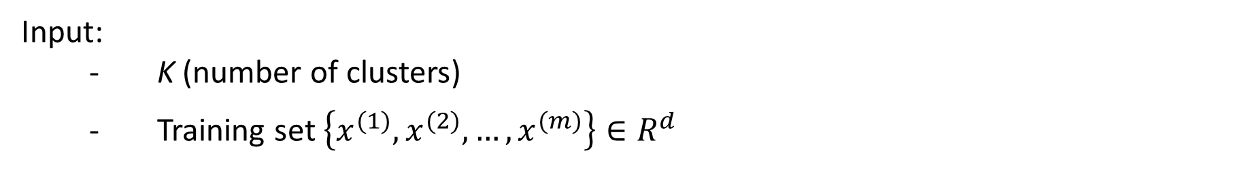
K-means algorithm
K-means algorithm is an iterative algorithm that tries to partition the dataset into K pre-defined distinct non-overlapping subgroups (clusters) where each data point belongs to only one group.
It tries to make the inter-cluster data points as similar as possible while also keeping the clusters as different (far) as possible.
Input:
K (number of clusters)
Training set $\left\{x^{(1)},x^{(2)},…,x^{(m)}\right\}∈R^{d}$

Slide 9
K-means algorithm
Specify number of clusters K.
Initialize centroids by first shuffling the dataset and then randomly selecting K data points for the centroids without replacement.
Keep iterating until there is no change to the centroids. i.e assignment of data points to clusters isn’t changing.
Compute the sum of the squared distance between data points and all centroids.
Assign each data point to the closest cluster (centroid).
Compute the centroids for the clusters by taking the average of the all data points that belong to each cluster.

Slide 10
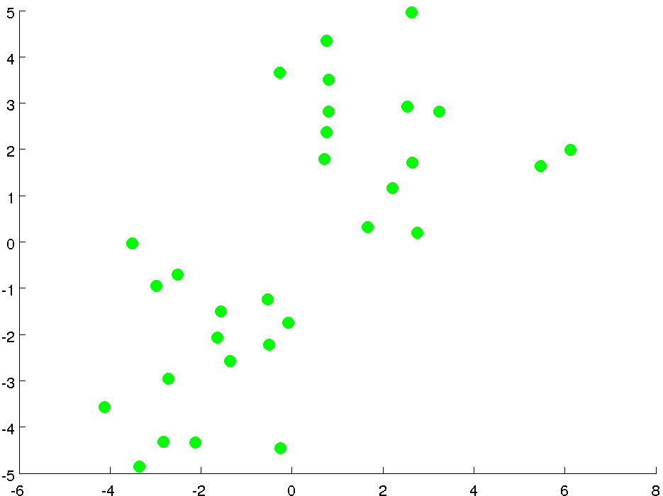

Slide 11
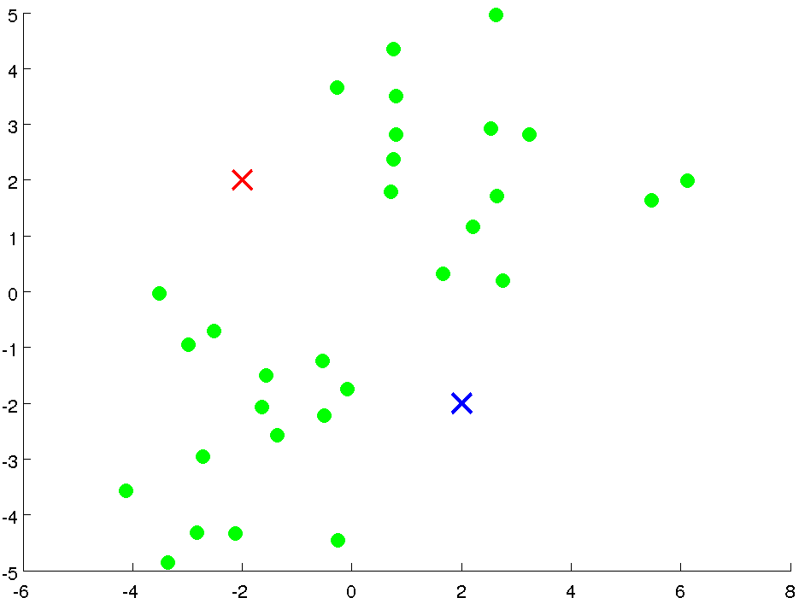

Slide 12
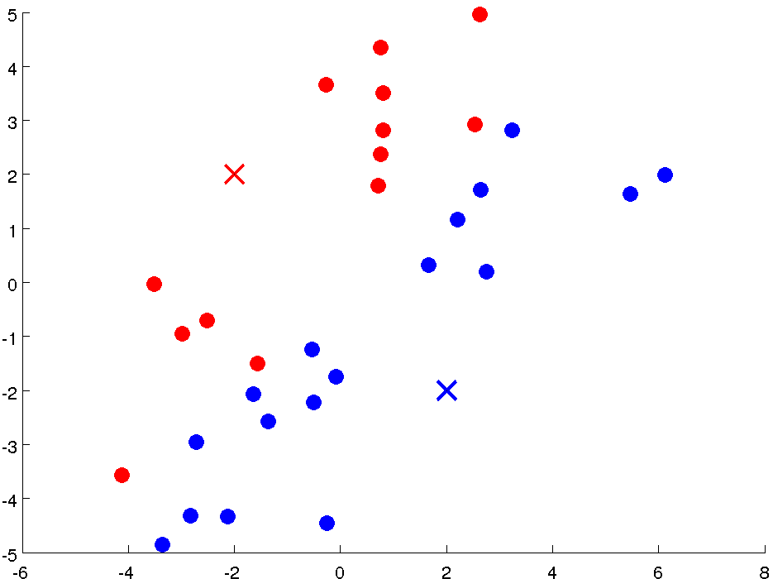

Slide 13
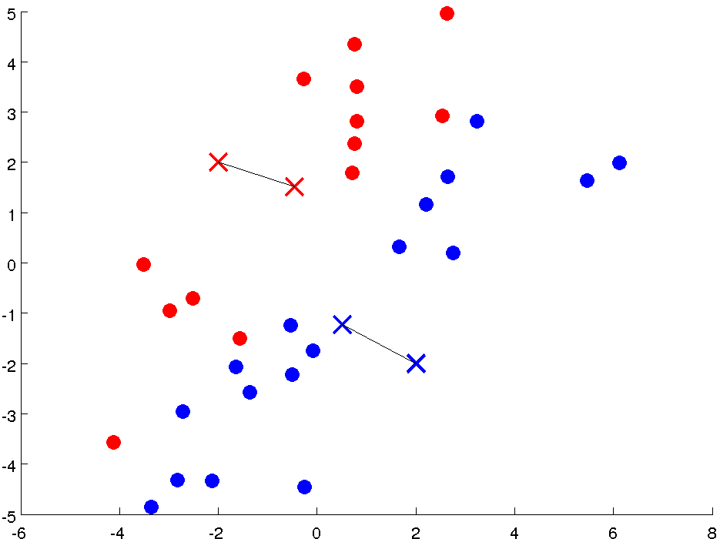

Slide 14
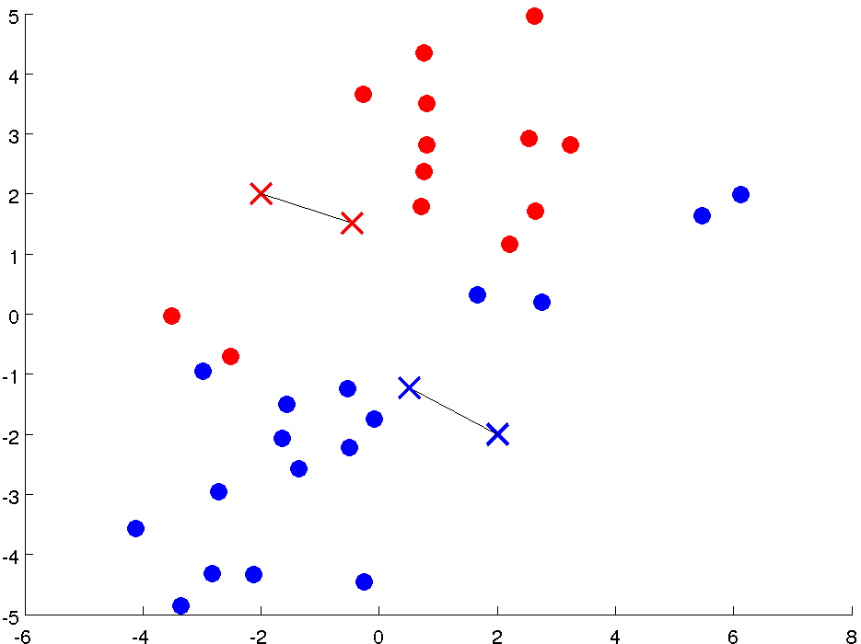

Slide 15
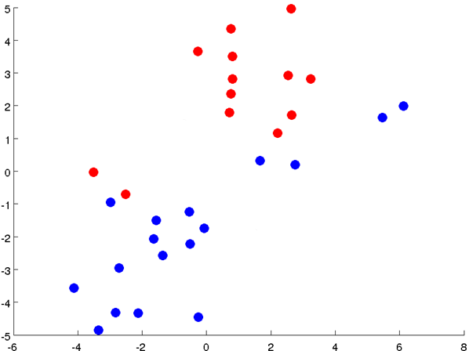

Slide 16
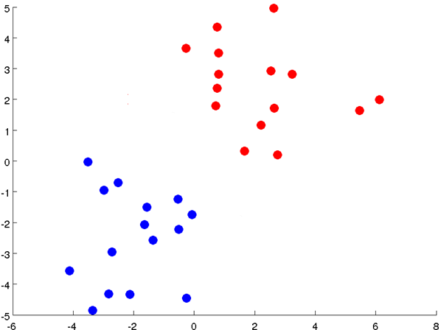

Slide 17
Notes:
Get rid of the legacy points

Slide 18
Notes:
Get rid of the legacy points

Slide 19
Applications
K-means algorithm is very popular and used in a variety of applications such as market segmentation, document clustering, image segmentation and image compression, etc.
The goal usually when we undergo a cluster analysis is either:
Get a meaningful intuition of the structure of the data we’re dealing with.
Cluster-then-predict where different models will be built for different subgroups if we believe there is a wide variation in the behaviors of different subgroups. An example of that is clustering patients into different subgroups and build a model for each subgroup to predict the probability of the risk of having heart attack.

Slide 20
Question. For which of the following tasks might K-means clustering be a suitable algorithm?
Given historical weather records, predict the amount of rainfall tomorrow (this would be a real-valued output)
(Incorrect). K-means cannot give real-valued outputs like regression, as the data have no real-valued labels.

Slide 21
Question. For which of the following tasks might K-means clustering be a suitable algorithm?
Given a database of information about your users, automatically group them into different market segments.
(Correct) You can use K-means to cluster the database entries, and each cluster will correspond to a different market segment.

Slide 22
Question. For which of the following tasks might K-means clustering be a suitable algorithm?
From the user usage patterns on a website, figure out what different groups of users exist.
Correct. We can cluster the users with K-means to find different, distinct groups.

Slide 23
Question. For which of the following tasks might K-means clustering be a suitable algorithm?
Given many emails, you want to determine if they are Spam or Non-Spam emails.
Incorrect. Classifying input as spam / non-spam requires labels for the data, which K-means does not use.

Slide 24
Question. For which of the following tasks might K-means clustering be a suitable algorithm?
Given historical weather records, predict if tomorrow's weather will be sunny or rainy.
Incorrect. K-means cannot make classification predictions, as it does not label its inputs.

Slide 25
Question. For which of the following tasks might K-means clustering be a suitable algorithm?
Given sales data from a large number of products in a supermarket, figure out which products tend to form coherent groups (say are frequently purchased together) and thus should be put on the same shelf.
Correct. If you cluster the sales data with K-means, each cluster should correspond to coherent groups of items.

Slide 26
Question. For which of the following tasks might K-means clustering be a suitable algorithm?
Given a set of news articles from many different news websites, find out what are the main topics covered.
Correct. K-means can cluster the articles and then we can inspect them or use other methods to infer what topic each cluster represents

Slide 27

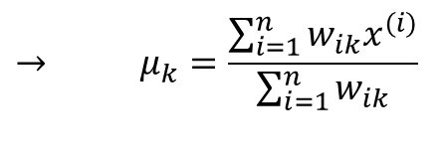
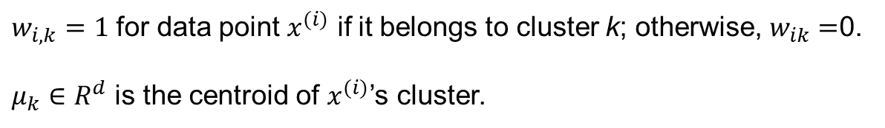
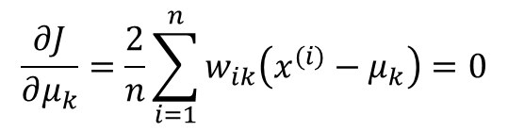
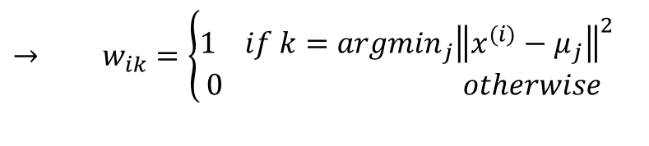
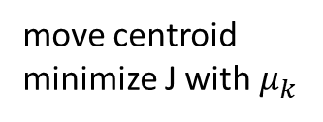
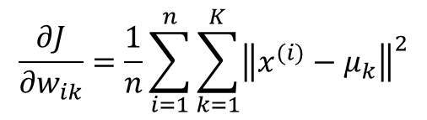
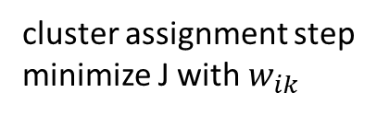
The objective function
$$J=\frac{1}{n}\sum_{i=1}^{n}{\sum_{k=1}^{K}{{w_{ik}\left\|x^{(i)}−μ_{k}\right\|}^{2}}}$$
$w_{i,k}=1$ for data point $x^{(i)}$ if it belongs to cluster k; otherwise, $w_{ik}=$0.
$μ_{k}∈R^{d}$ is the centroid of $x^{(i)}$’s cluster.
cluster assignment step
minimize J with $w_{ik}$
$$\frac{∂J}{∂w_{ik}}=\frac{1}{n}\sum_{i=1}^{n}{\sum_{k=1}^{K}{{\left\|x^{(i)}−μ_{k}\right\|}^{2}}}$$
$$→ w_{ik}=\left\{\begin{aligned}1 if k={argmin}_{j}{\left\|x^{(i)}−μ_{j}\right\|}^{2} \\ 0 otherwise \end{aligned}\right.$$
move centroid
minimize J with $μ_{k}$
$$\frac{∂J}{∂μ_{k}}=\frac{2}{n}\sum_{i=1}^{n}{w_{ik}\left(x^{(i)}−μ_{k}\right)}=0$$
$$→ μ_{k}=\frac{\sum_{i=1}^{n}{w_{ik}x^{(i)}}}{\sum_{i=1}^{n}{w_{ik}}}$$
https://towardsdatascience.com/k-means-clustering-algorithm-applications-evaluation-methods-and-drawbacks-aa03e644b48a

Slide 28
K-means algorithm
Specify number of clusters K. Initialize centroids by first shuffling the dataset and then randomly selecting K data points for the centroids without replacement.
Keep iterating until there is no change to the centroids. i.e assignment of data points to clusters isn’t changing.
Compute the sum of the squared distance between data points and all centroids.
Assign each data point to the closest cluster (centroid).
Compute the centroids for the clusters by taking the average of the all data points that belong to each cluster.
cluster assignment step
move centroid
Since clustering algorithms including k-means use distance-based measurements to determine the similarity between data points, it’s recommended to standardize the data to have a mean of zero and a standard deviation of one since almost always the features in any dataset would have different units of measurements such as age vs income.

Slide 29
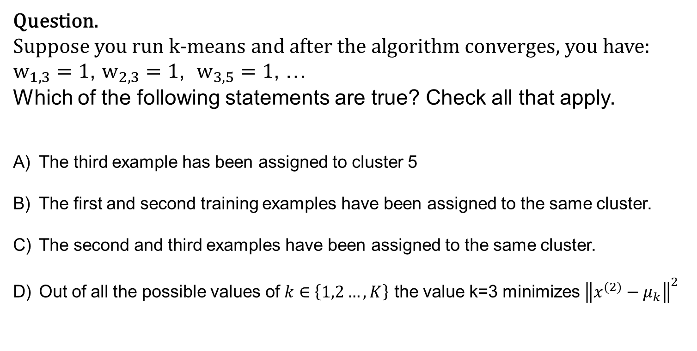
Question.
Suppose you run k-means and after the algorithm converges, you have:
$w_{1,3}=1$, $w_{2,3}=1$, $w_{3,5}=1$, …
Which of the following statements are true? Check all that apply.
The third example has been assigned to cluster 5
The first and second training examples have been assigned to the same cluster.
The second and third examples have been assigned to the same cluster.
Out of all the possible values of $k∈\left\{1,2…,K\right\}$ the value k=3 minimizes ${\left\|x^{(2)}−μ_{k}\right\|}^{2}$

Slide 30
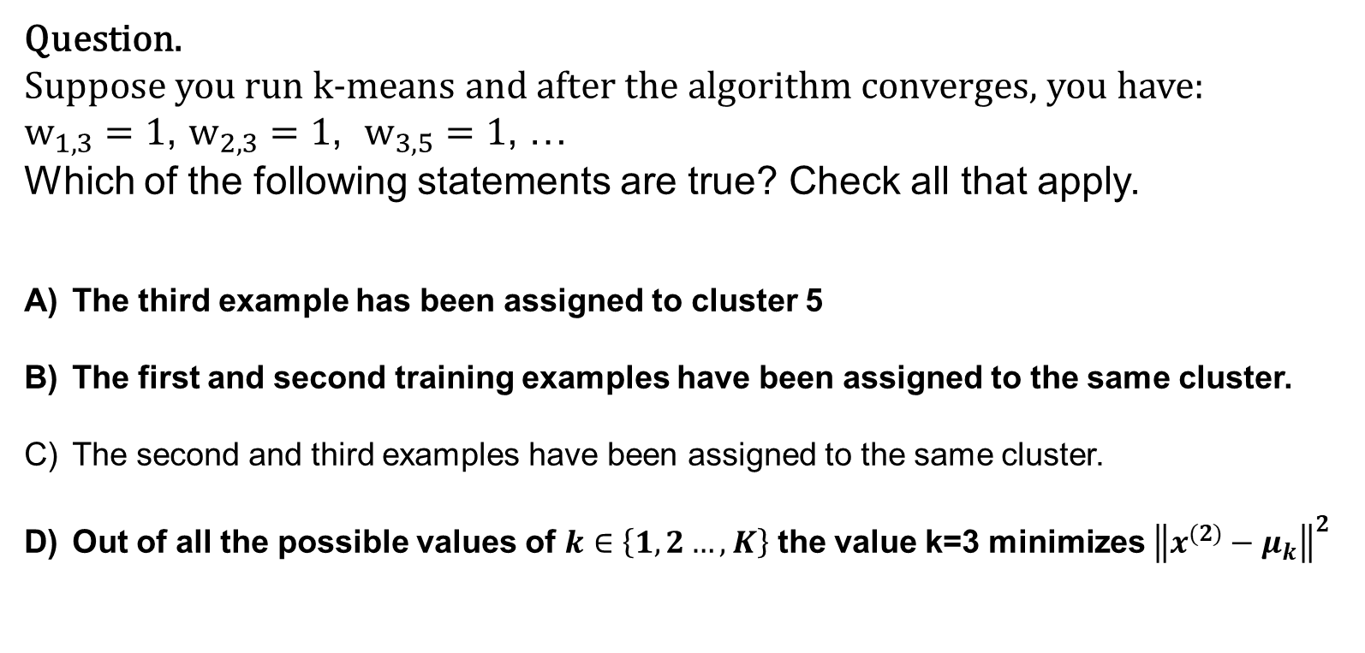
Question.
Suppose you run k-means and after the algorithm converges, you have:
$w_{1,3}=1$, $w_{2,3}=1$, $w_{3,5}=1$, …
Which of the following statements are true? Check all that apply.
The third example has been assigned to cluster 5
The first and second training examples have been assigned to the same cluster.
The second and third examples have been assigned to the same cluster.
Out of all the possible values of $k∈\left\{1,2…,K\right\}$ the value k=3 minimizes ${\left\|x^{(2)}−μ_{k}\right\|}^{2}$

Slide 31
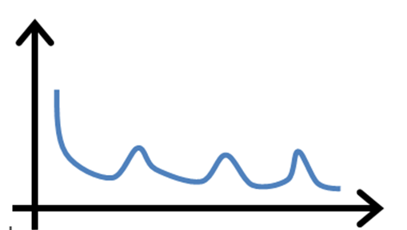
Question.
Suppose you have implemented k-means and to check that it is running correctly, you plot the cost function J as a function of the number of iterations. Your plot looks like this:
The learning rate is too large
The algorithm is working correctly
The algorithm is working, but k is too large
It is not possible for the cost function to sometimes increase. There must be a bug in the code.

Slide 32
Question.
Suppose you have implemented k-means and to check that it is running correctly, you plot the cost function J as a function of the number of iterations. Your plot looks like this:
The learning rate is too large
The algorithm is working correctly
The algorithm is working, but k is too large
It is not possible for the cost function to sometimes increase. There must be a bug in the code.

Slide 33
Local 0ptima
Given k-means iterative nature and the random initialization of centroids at the start of the algorithm, different initializations may lead to different clusters since k-means algorithm may stuck in a local optimum and may not converge to global optimum.

Slide 34
Local optima
https://www.youtube.com/watch?v=nXY6PxAaOk0

Slide 35
Random initialization
It’s recommended to run the algorithm using different initializations of centroids and pick the results of the run that yielded the lower sum of squared distance.
For i = 1 to 100 { Randomly initialize K-means.
Run K-means. Compute cost function (distortion).
}
Pick clustering that gave lowest cost

Slide 36
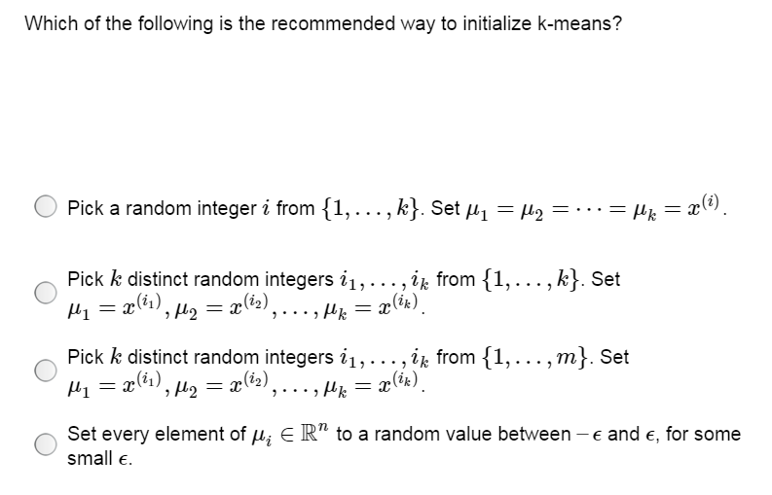

Slide 37
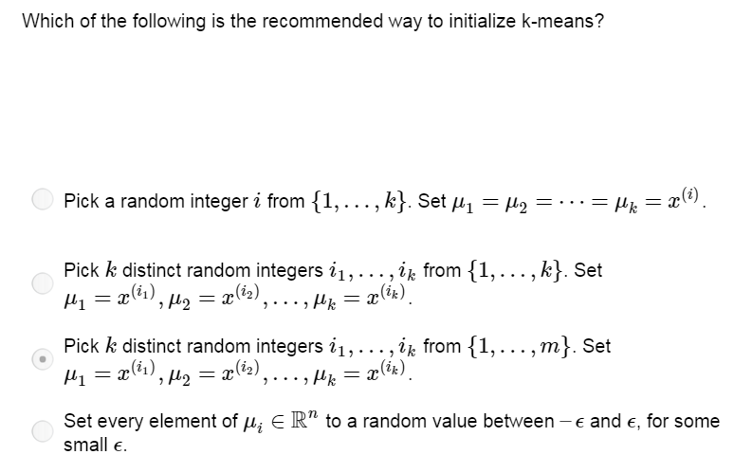

Slide 38
Choosing the number of clusters

Slide 39
What is the right value of K?

Slide 40
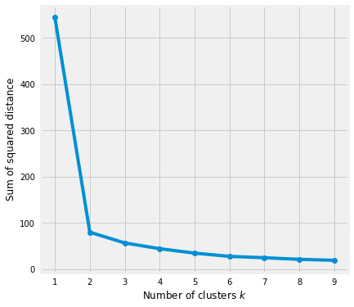
Elbow Method
Elbow method gives us an idea on what a good k number of clusters would be based on the sum of squared distance (SSE) between data points and their assigned clusters’ centroids. We pick k at the spot where SSE starts to flatten out and forming an elbow.
geyser dataset
Elbow
https://towardsdatascience.com/k-means-clustering-algorithm-applications-evaluation-methods-and-drawbacks-aa03e644b48a

Slide 41



Silhouette Analysis
$$x^{(i)}$$
Silhouette analysis can be used to determine the degree of separation between clusters. For each sample:
Compute the average distance from all data points in the same cluster ($a^{i}$).
Compute the average distance from all data points in the closest cluster ($b^{i}$).
Compute the coefficient:
The coefficient can take values in the interval [-1, 1].
Values close to 1 suggest that the observation is well matched to the assigned cluster
Values close to 0 suggest that the observation is borderline matched between two clusters
Values close to -1 suggest that the observations may be assigned to the wrong cluster

Slide 42
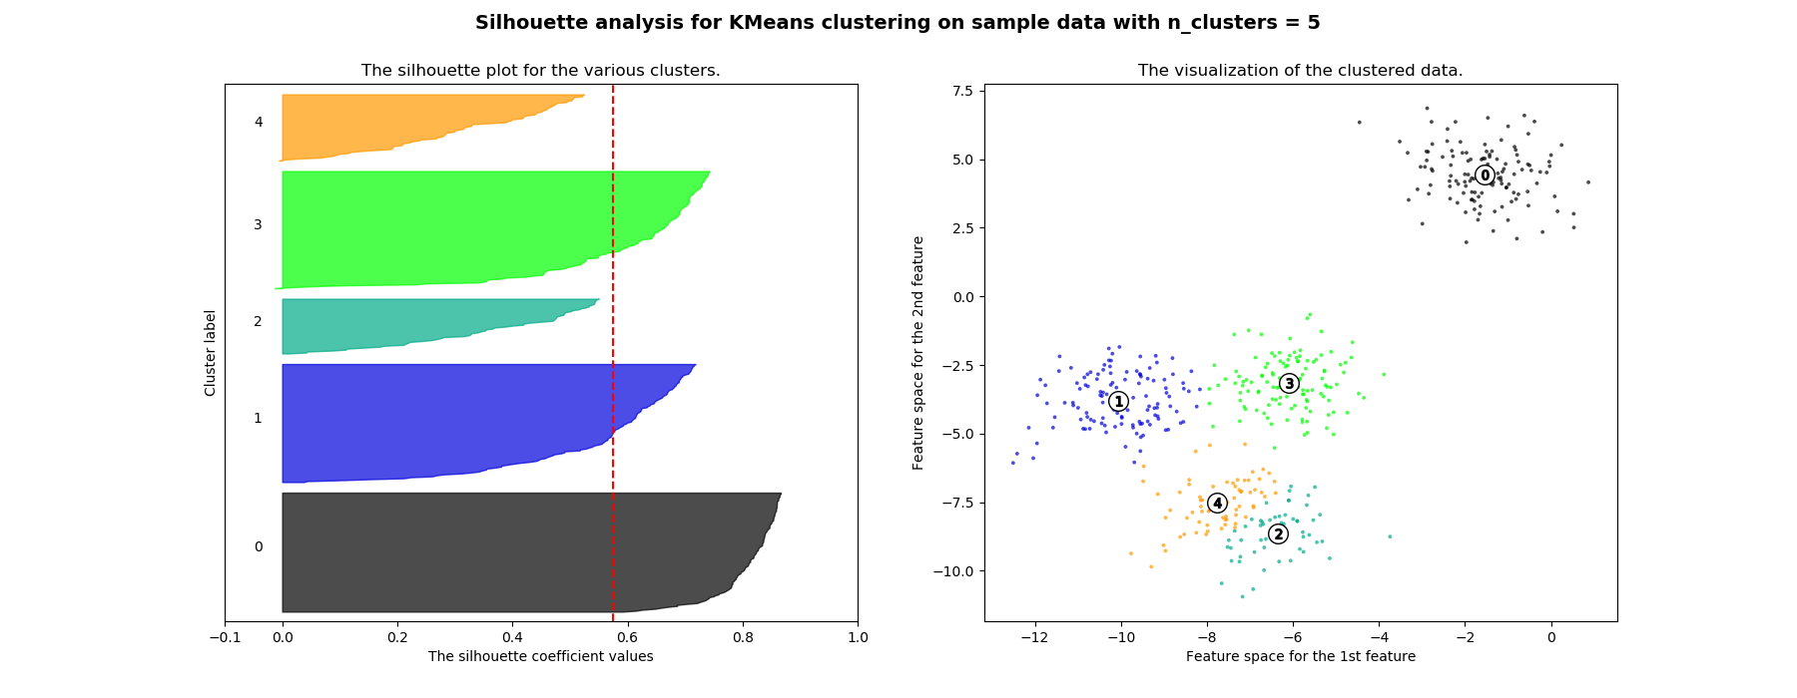
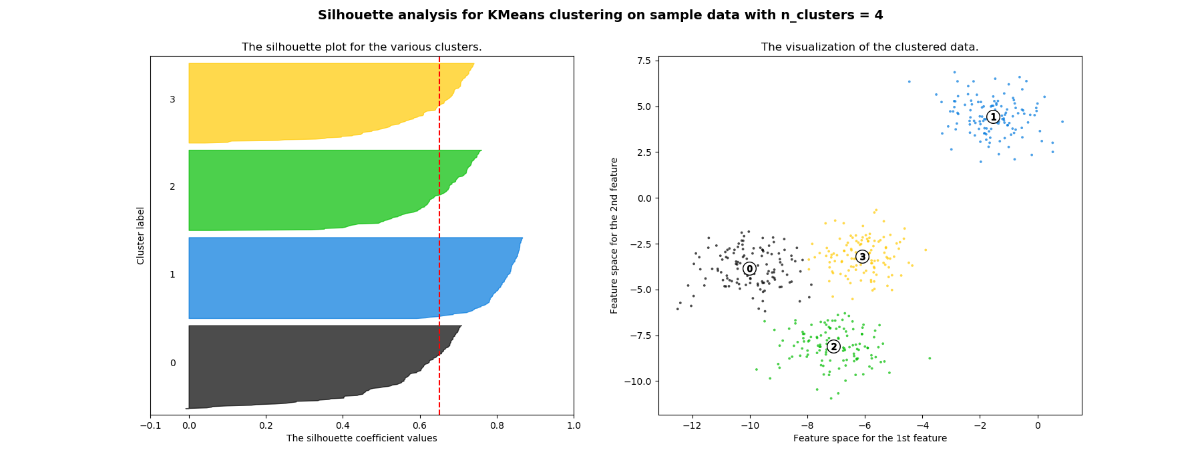
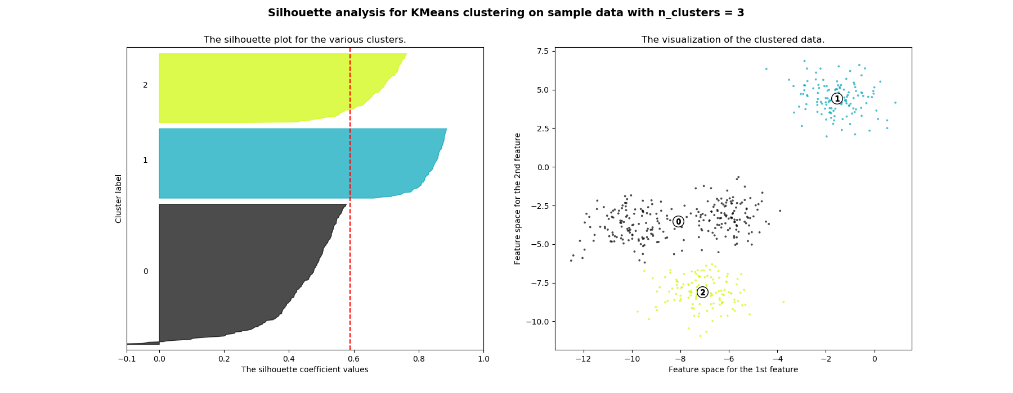
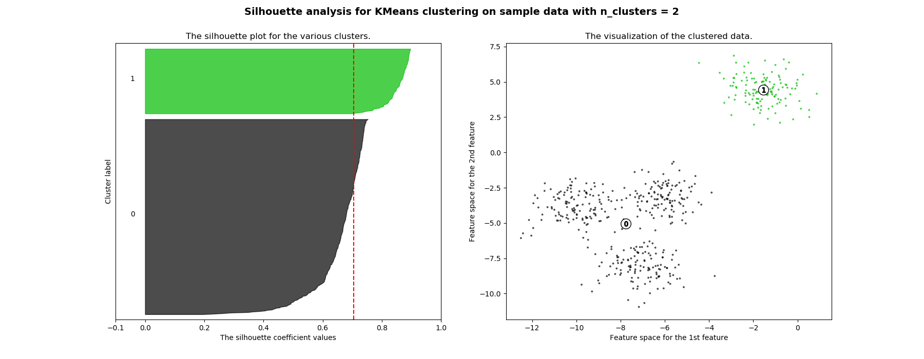
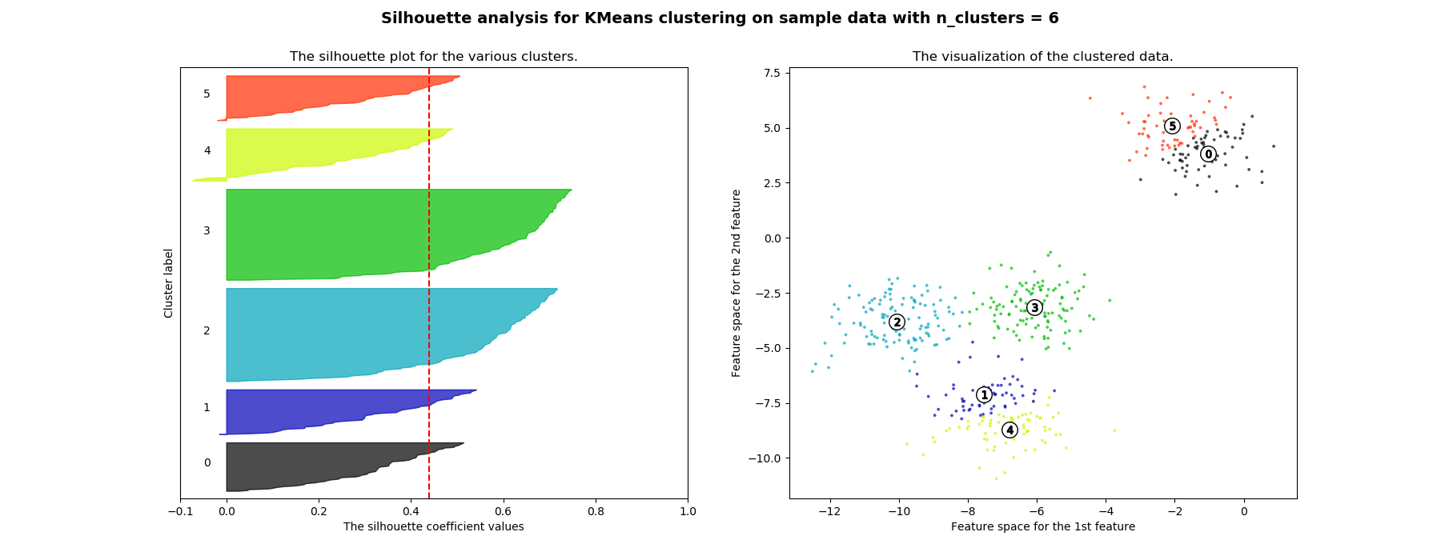
For n_clusters = 2 The average silhouette_score is : 0.7049787496083262
For n_clusters = 3 The average silhouette_score is : 0.5882004012129721
For n_clusters = 4 The average silhouette_score is : 0.6505186632729437
For n_clusters = 5 The average silhouette_score is : 0.5745566973301872
For n_clusters = 6 The average silhouette_score is : 0.43902711183132426
https://scikit-learn.org/stable/auto_examples/cluster/plot_kmeans_silhouette_analysis.html

Slide 43


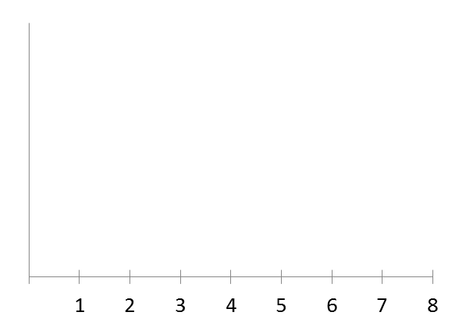

Choosing the value of K
Elbow method:
Cost function
Cost function
(no. of clusters)
(no. of clusters)

Slide 44
Choosing the value of K
Sometimes, you’re running K-means to get clusters to use for some later/downstream purpose. Evaluate K-means based on a metric for how well it performs for that later purpose.
E.g.
T-shirt sizing
T-shirt sizing
Weight
Weight
Height
Height

Slide 45
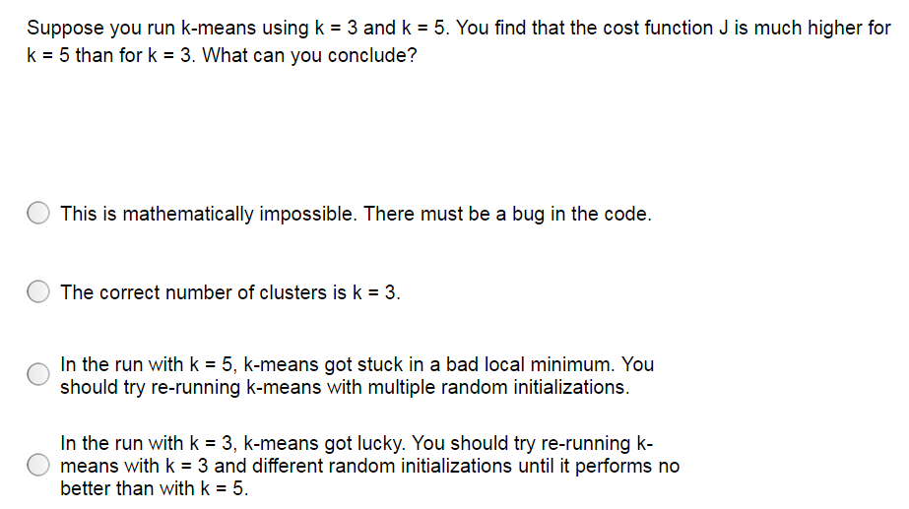

Slide 46
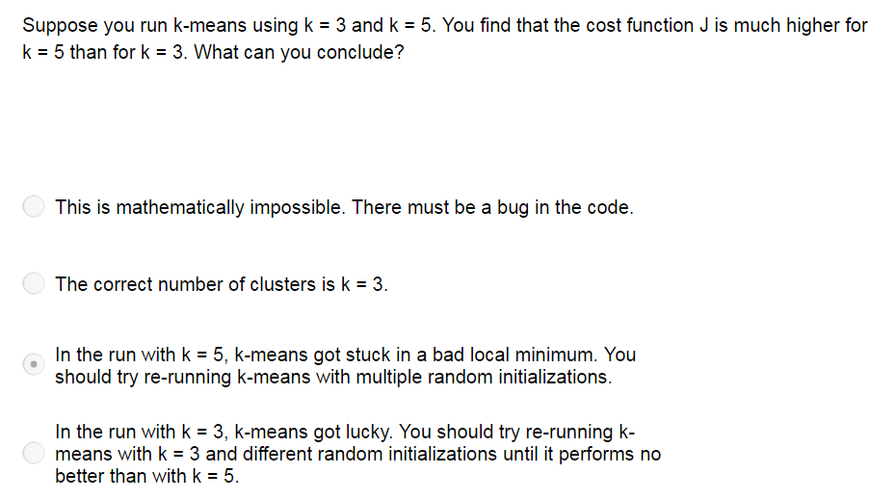

Slide 47
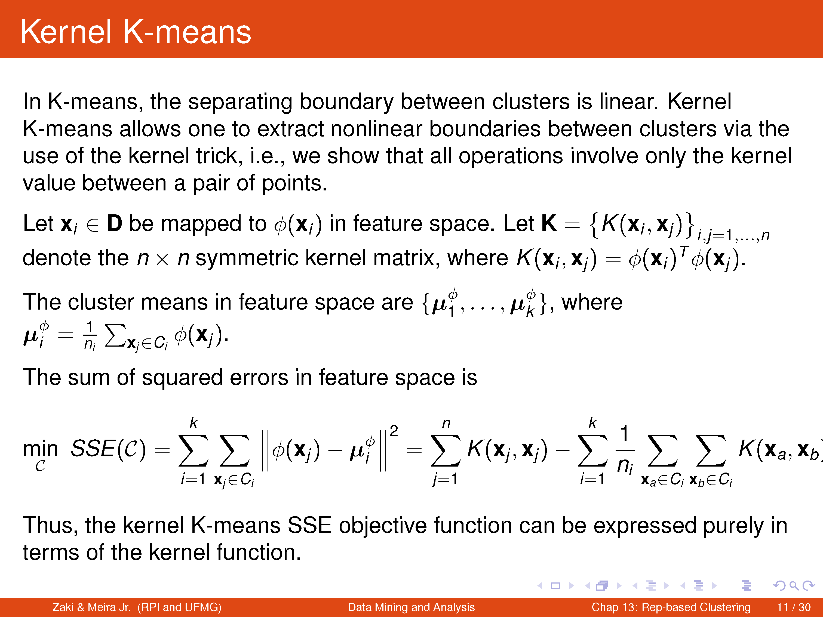
Optional

Slide 48
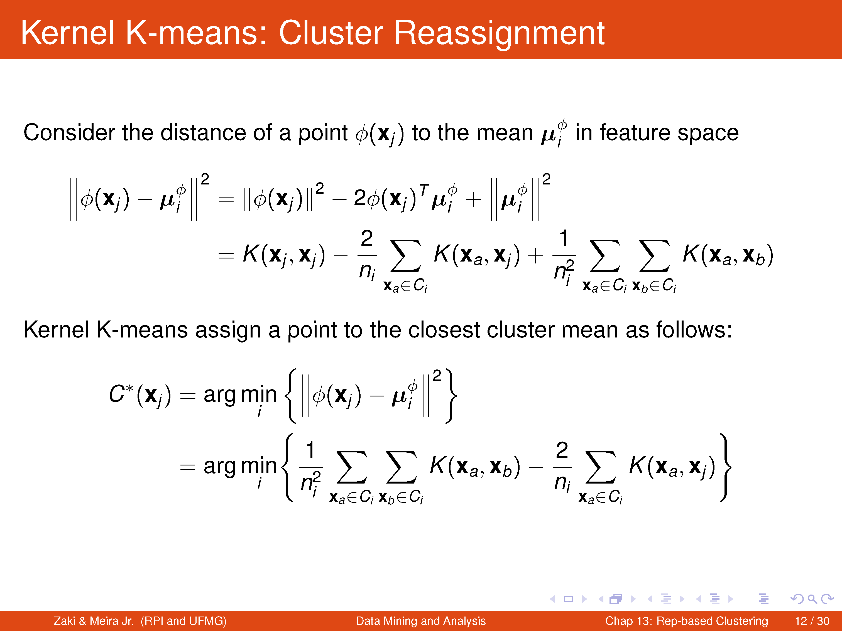
Optional

Slide 49
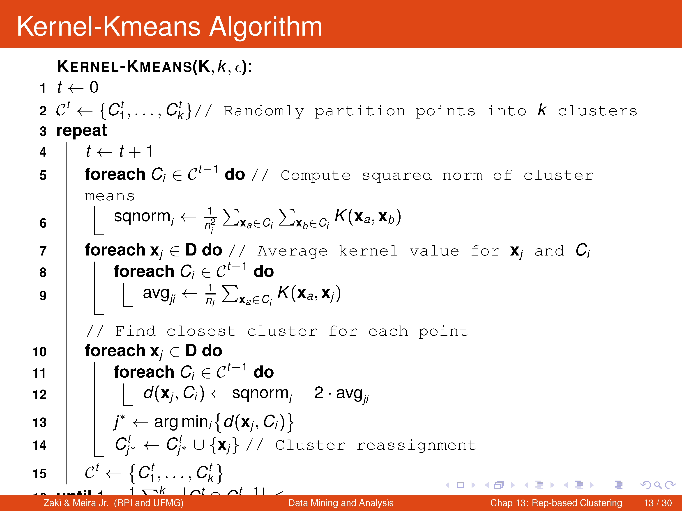
Optional

Slide 50
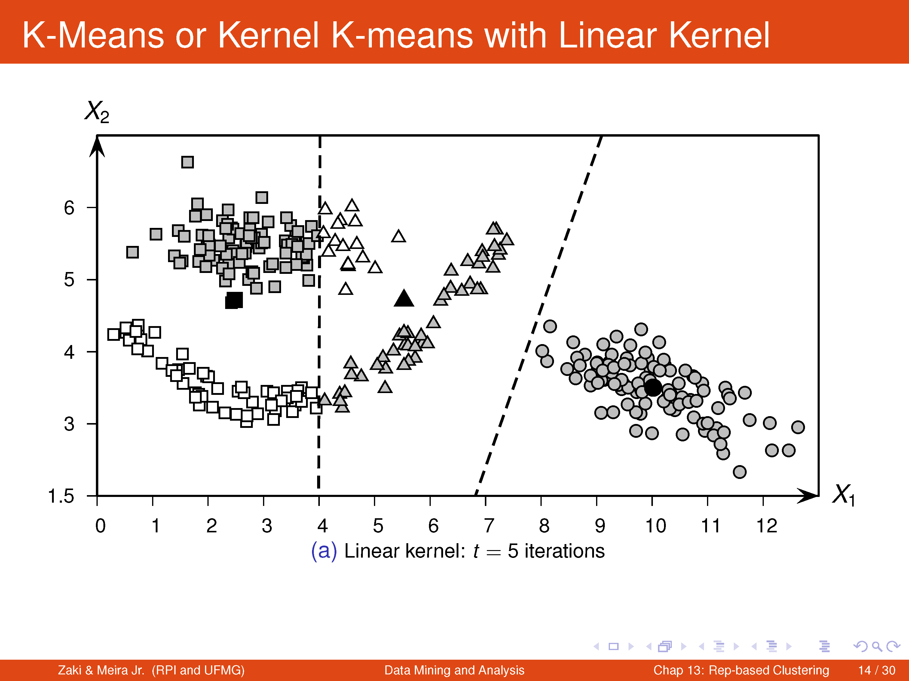
Optional

Slide 51
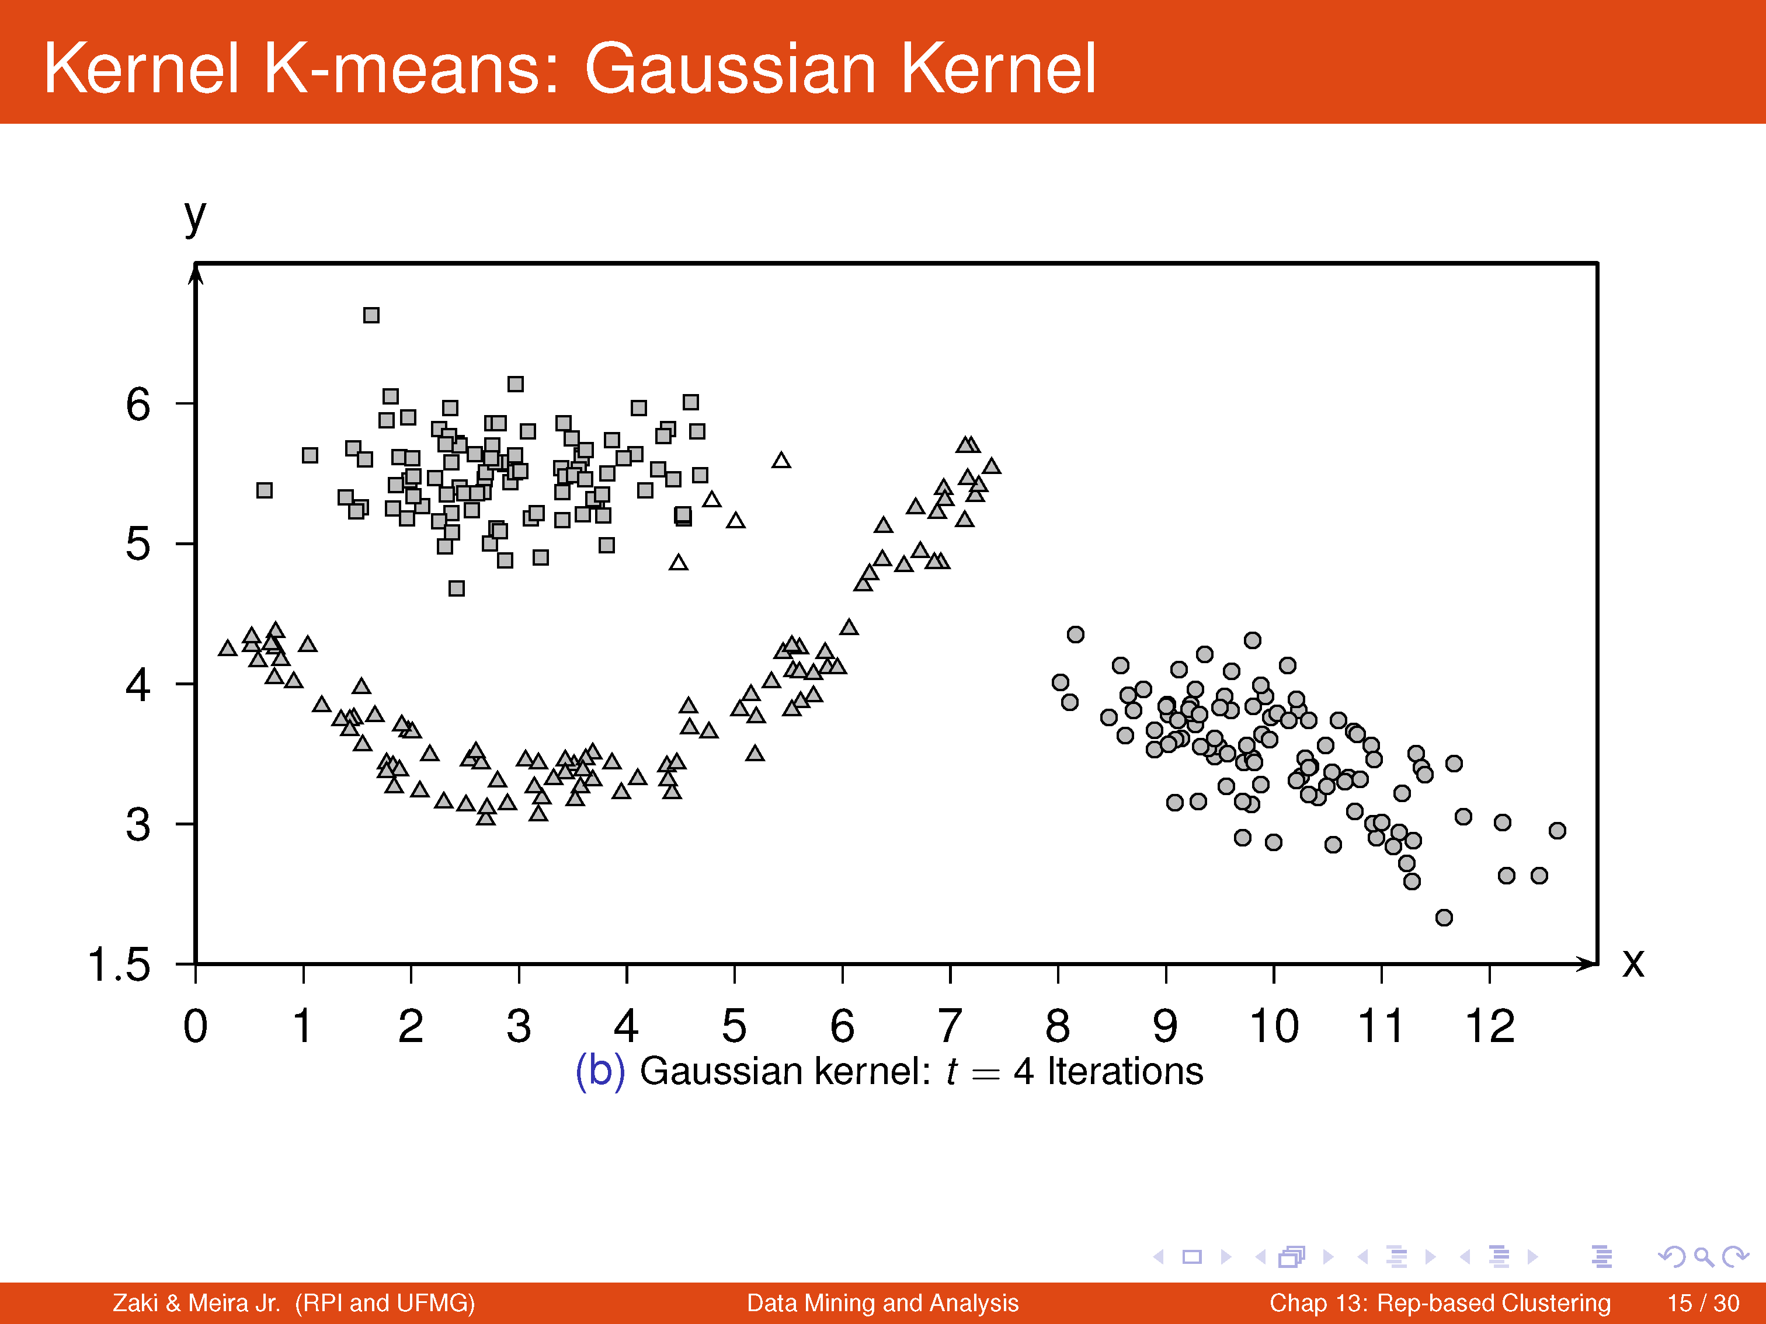
Optional

Slide 52

Reading Materials
K-means Algorithm.Data Mining and Analysis: Fundamental Concepts and Algorithms Mohammed J. Zaki, Wagner Meira Jr.
The k-means clustering algorithm. Andrew Ng http://cs229.stanford.edu/notes/cs229-notes7a.pdf
K-means Clustering: Algorithm, Applications, Evaluation Methods, and Drawbacks. Imad Dabbura.
https://towardsdatascience.com/k-means-clustering-algorithm-applications-evaluation-methods-and-drawbacks-aa03e644b48a

